Slide 1
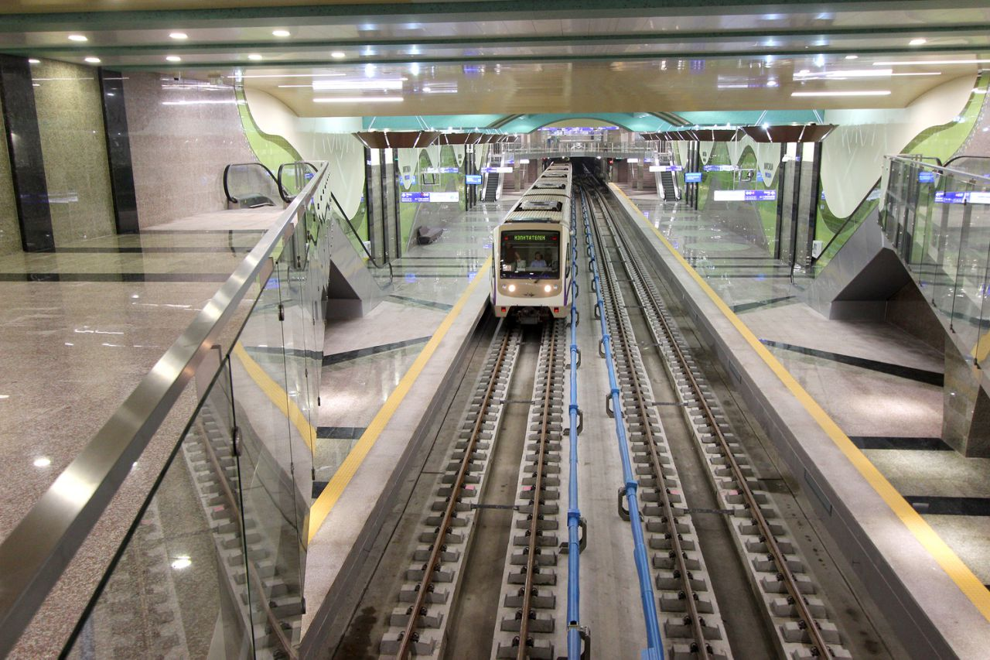
SOFIA METRO EXTENSION PROJECT INCLUDED IN THE OPTTI 2014-2020 г.
MS Vitosha – commissioned on 20.07.2016

Slide 2
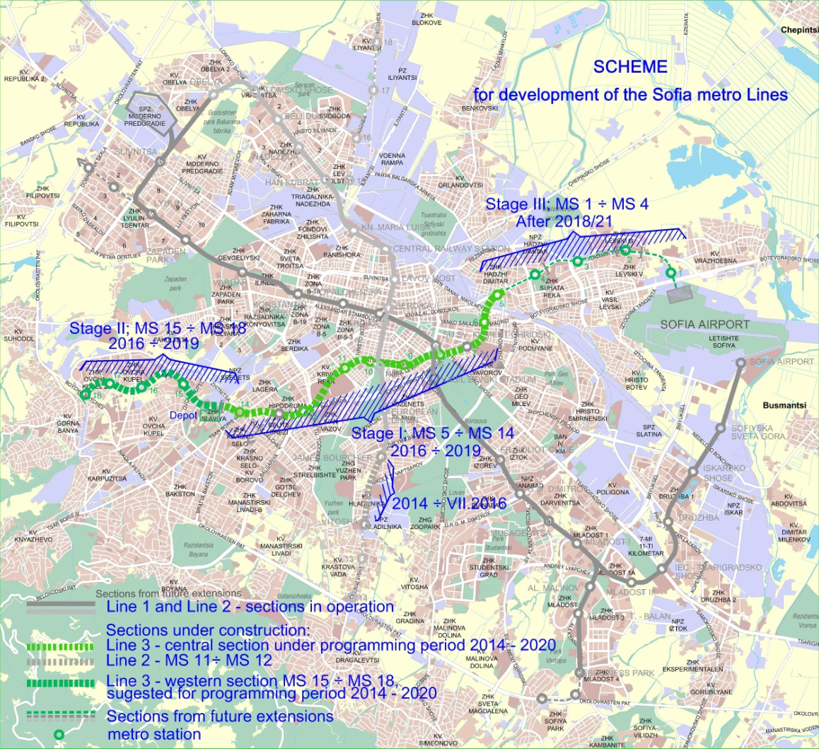
S C H E M E
of location of Sofia Metro sections included in the OPTTI 2014-2020 – Stage 1 and 2 of Line 3 and the extension of Line 2 “MS J. Bourchier – MS Vitosha”

Slide 3
1. Extension of Line 2: Section “MS J. Bourchier (MS ІІ-11) – MS Vitosha (MS ІІ-12)” and equipment for changing the traffic direction after MS “Vitosha” /2014-2016/
- Length – 1.3 km - underground
- Number of stations - 1 underground
- Scope of construction - 950 m underground according to NATM
metro station and underpass facilities – cut-and-cover method in a reinforced ditch and the adjacent engineering infrastructure.
- Achieved tender price – EUR 21.6 mln. /EUR 17 mln/km/
Phase 1 – under OPT 2007-2013; Phase 2 – under OPTTI 2014-2020.
- Construction duration - 22 months starting on 08. 2014.
Completed - 06.2016. Put into operation – 07.2016
- Contractors: Tunnel – Stanilov Ltd.; Metro station – G.P. Group Ltd.
- Beneficiary - SM – Metropoliten JSC

Slide 4
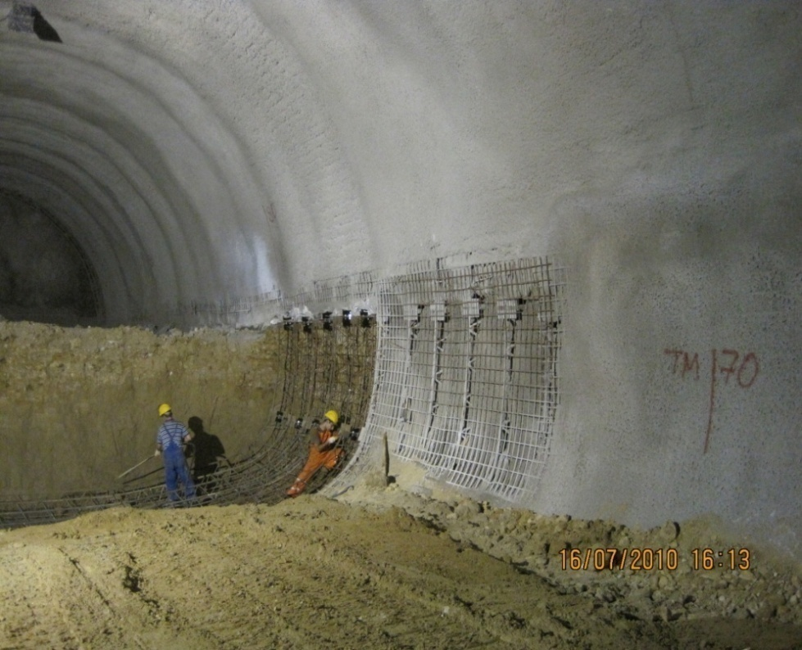
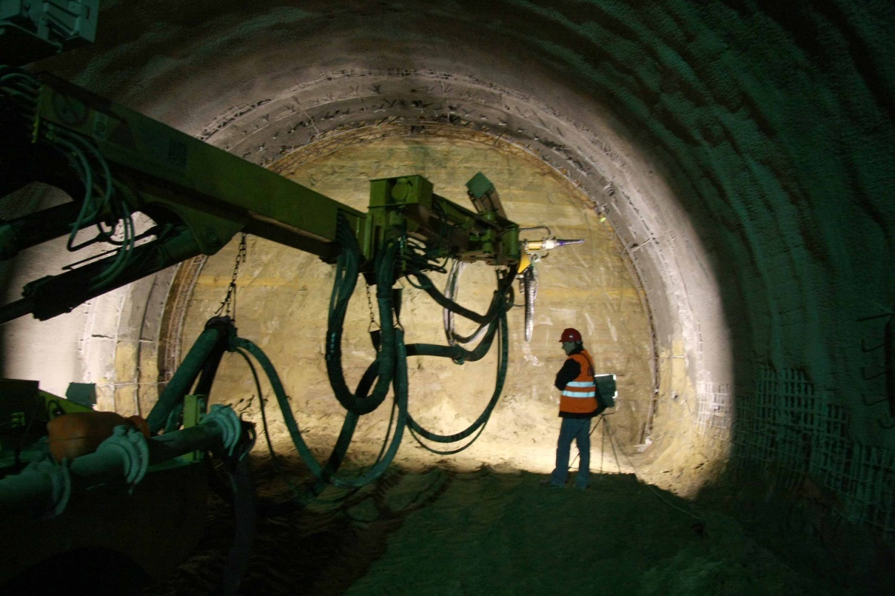
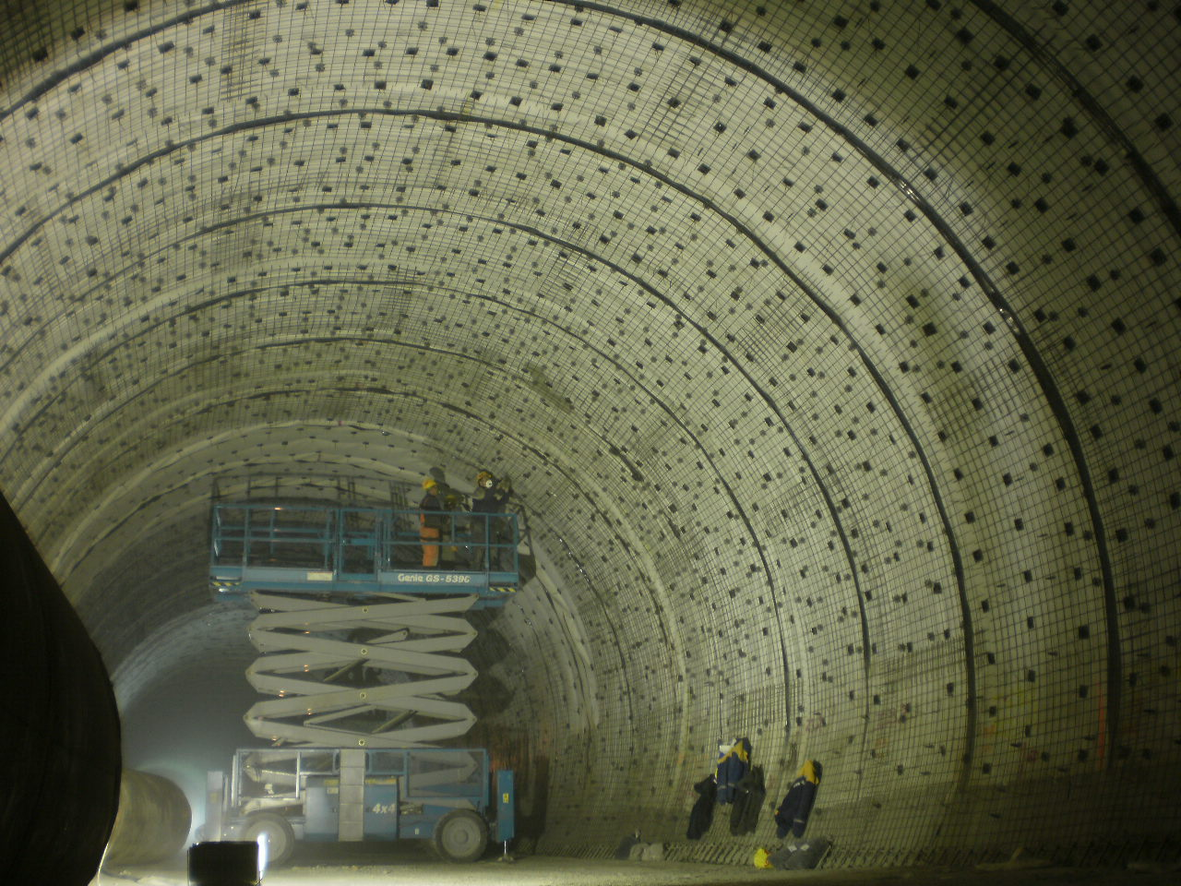
Technology phases of the construction of the
Tunnel under Cherni Vrah blvd. under NATM
- Execution of excavation works of the
calotte and the structure of the arch
- Execution of the works related to
excavation of the bench and construction
of the invert
- Execution of the internal lining of the
double-layered structure

Slide 5
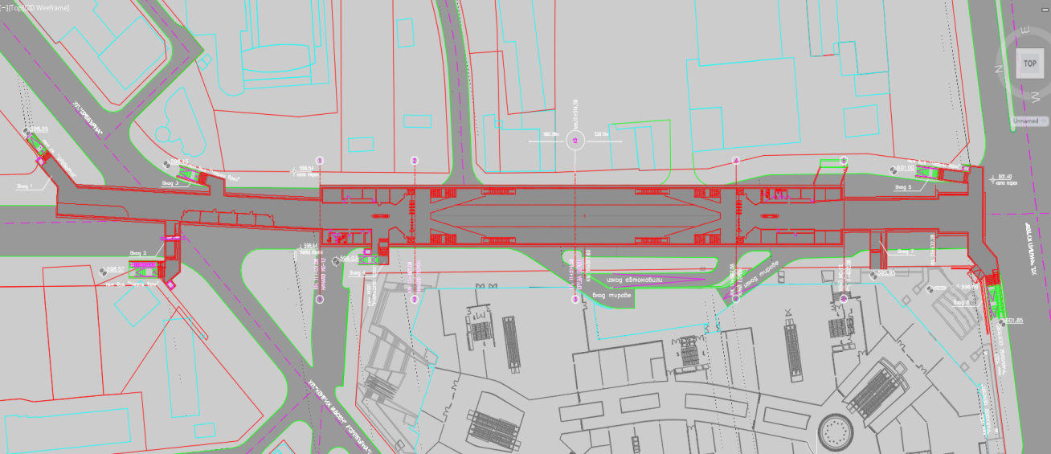
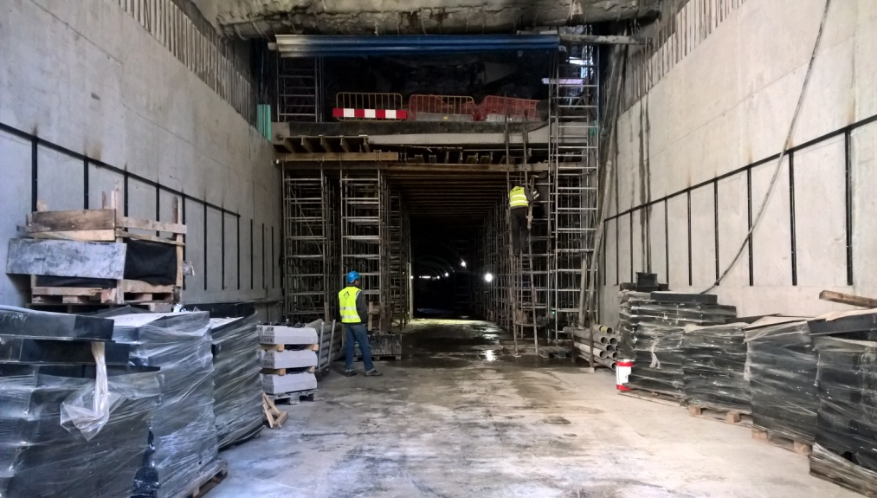
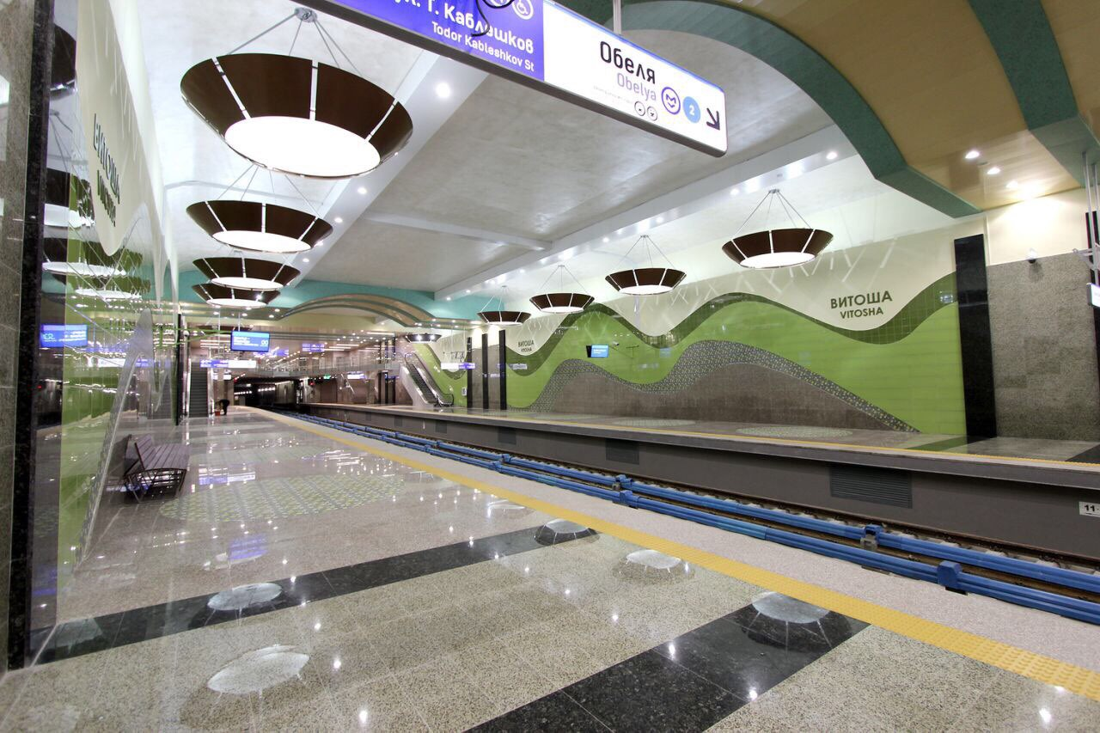
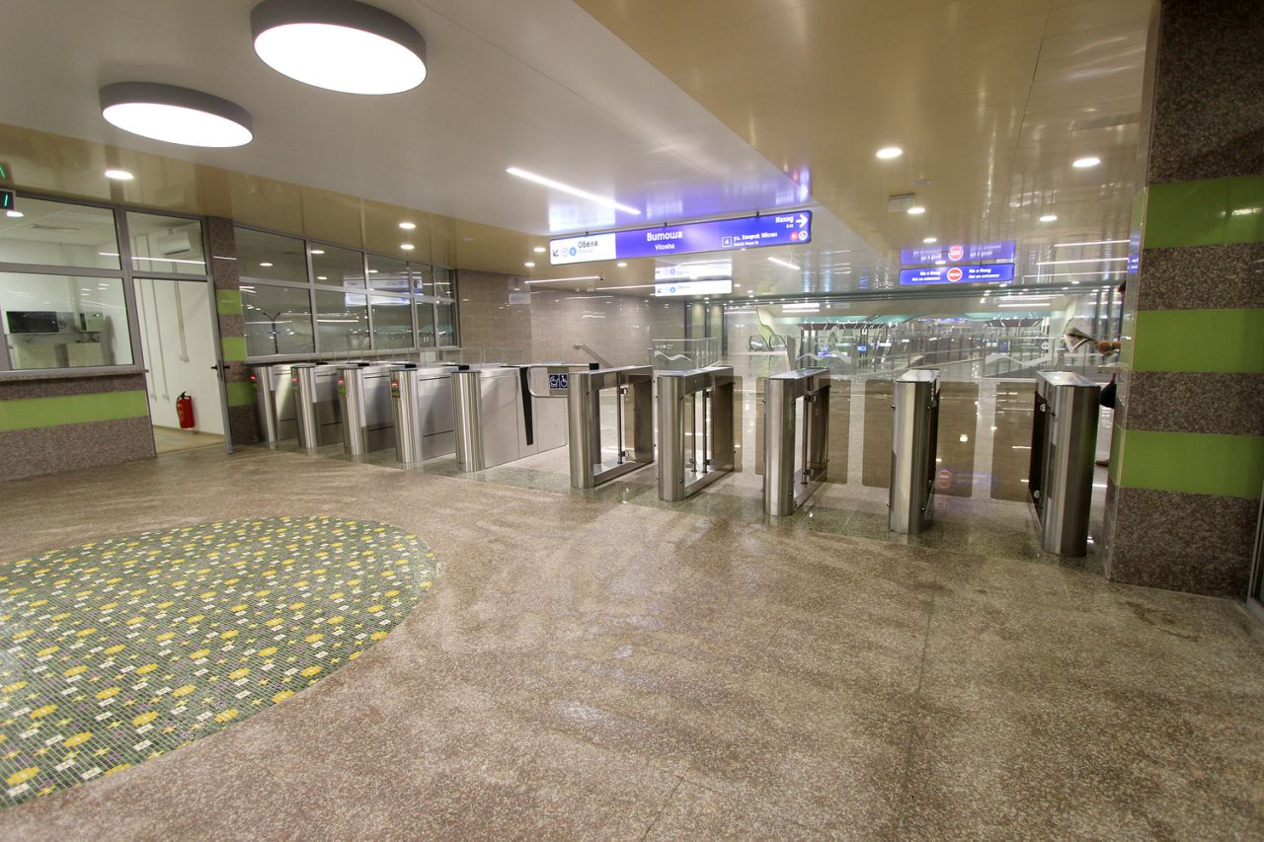
Ул.Сребърна
Бул.Т.Каблешков
MS 12-2 /Vitosha/ - commissioned on 20.07.2016
location in the urban layout, construction and view

Slide 6
2. Project of the construction of Line 3 - Stage 1 and 2 /2016-2019/
Approved route of Line 3 - 2012: “Vl. Vazov blvd. – Orlov Most - NDK – Krasno Selo – Ovcha
Kupel RD”: Length - 16 km with 16 stations and expected passenger flow of 170 thousand passengers/day;
Completed works related to preparation of the project of Line 3 - 2011-2014:
- Developed route options. Technical-economic justification. Public discussions conducted - 14,15,16.10.2011 and 26.09.
Route approved by the expert counc СО
- Preliminary design - 2010 - 2013; Tender documentations; EIA documentation, EIA decision. Amend. of
GMP and detailed master plans - 2012 – 2015
Preparation of the project of Line 3 for financing under OPTTI 2014-20 – Cost-Benefit Analysis and
Application form – Stage 1 - 2015 /Approved by the EC/, Stage 2 –CBA and AP submitted to the MA –
10.2016:
Phases of construction during the period 2016-2020 included in the OPTTI: Stage 1 and Stage 2
Stage 1: “Vladimir Vazov blvd. – Orlov Most – NDK – Krasno Selo”
- Length: 8 km and 8 metro stations
- Depot and 20 trains
- Start of construction – January 2016 /MS 5 and depot – end of 2016/
- Construction duration - 2016-2019
Stage ІІ: “Krasno Selo RD - Ovcha Kupel RD – Sofia-Pernik rail line”
- Length: 4 km and 4 metro stations and railway stop at MS18.
- Start of construction – phased , starting in the beginning of 2017
- Construction duration 2017-2019
Financing of Stage 1 and Stage ІІ: - OPTTI - EUR 391 mln.
- local – EUR 102 mln.

Slide 7
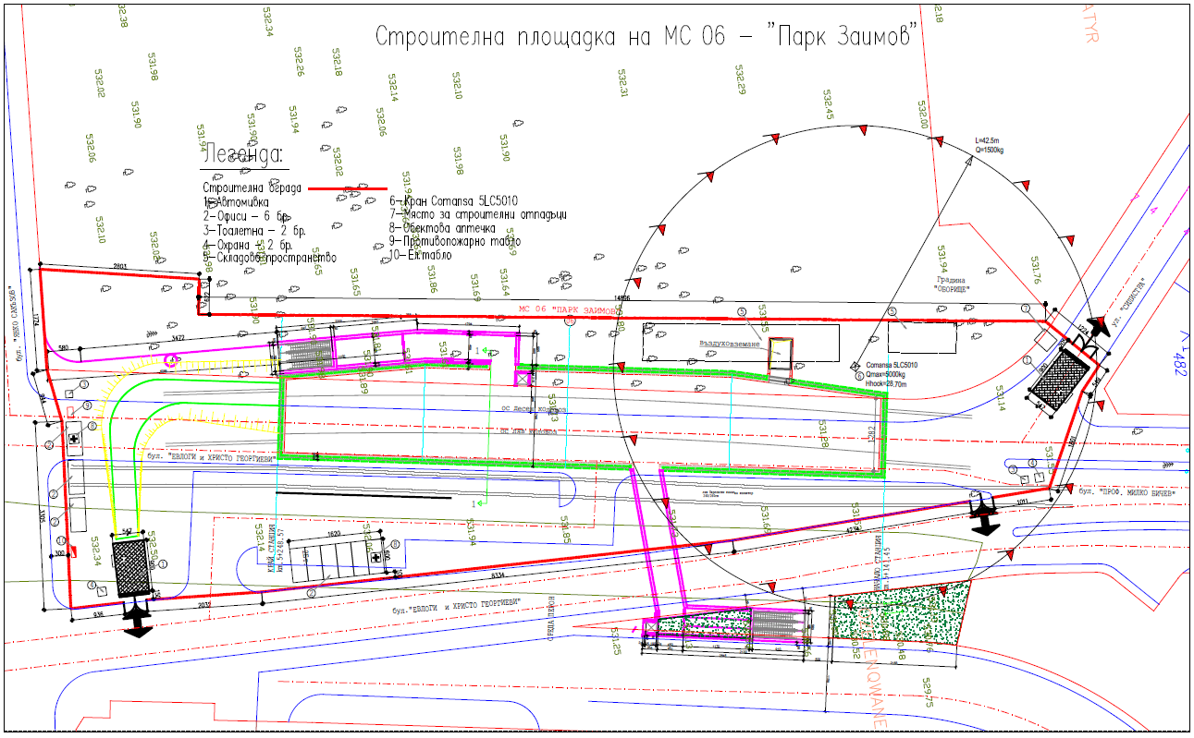
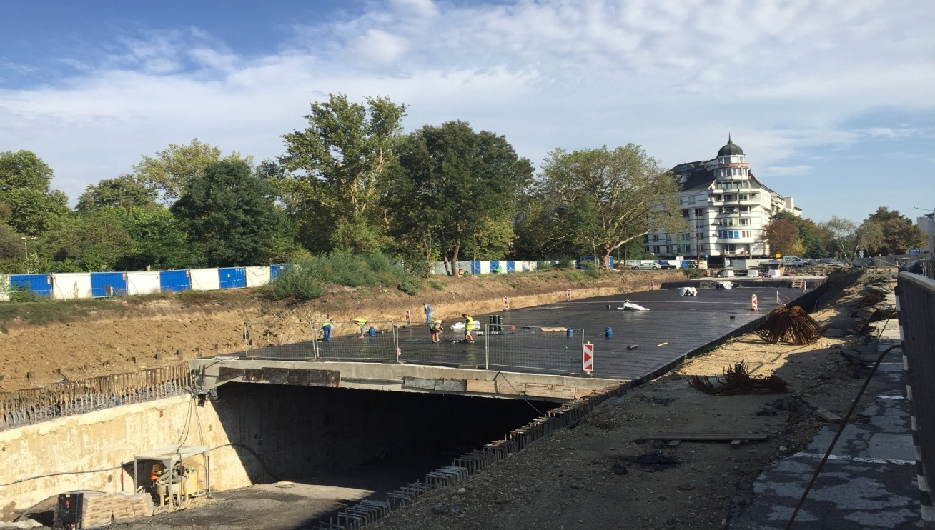
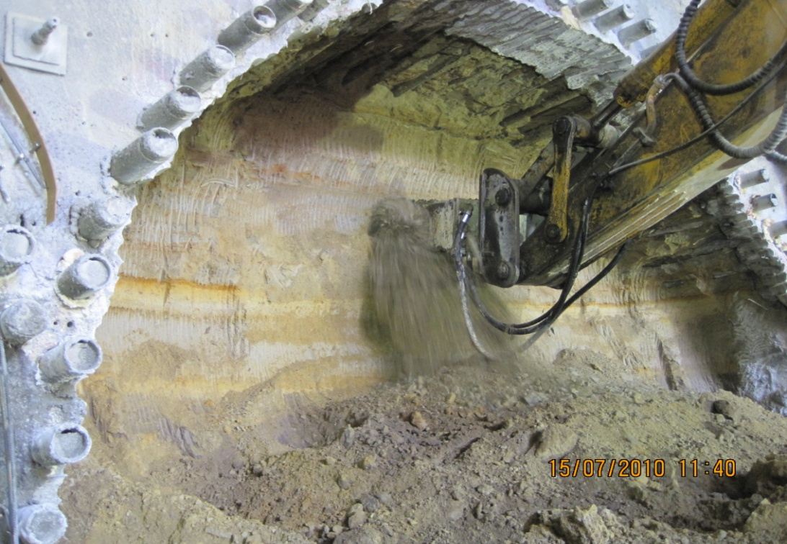
Location in the urban layout and construction of MS 6 /near the Off-The-Channel theatre/

Slide 8
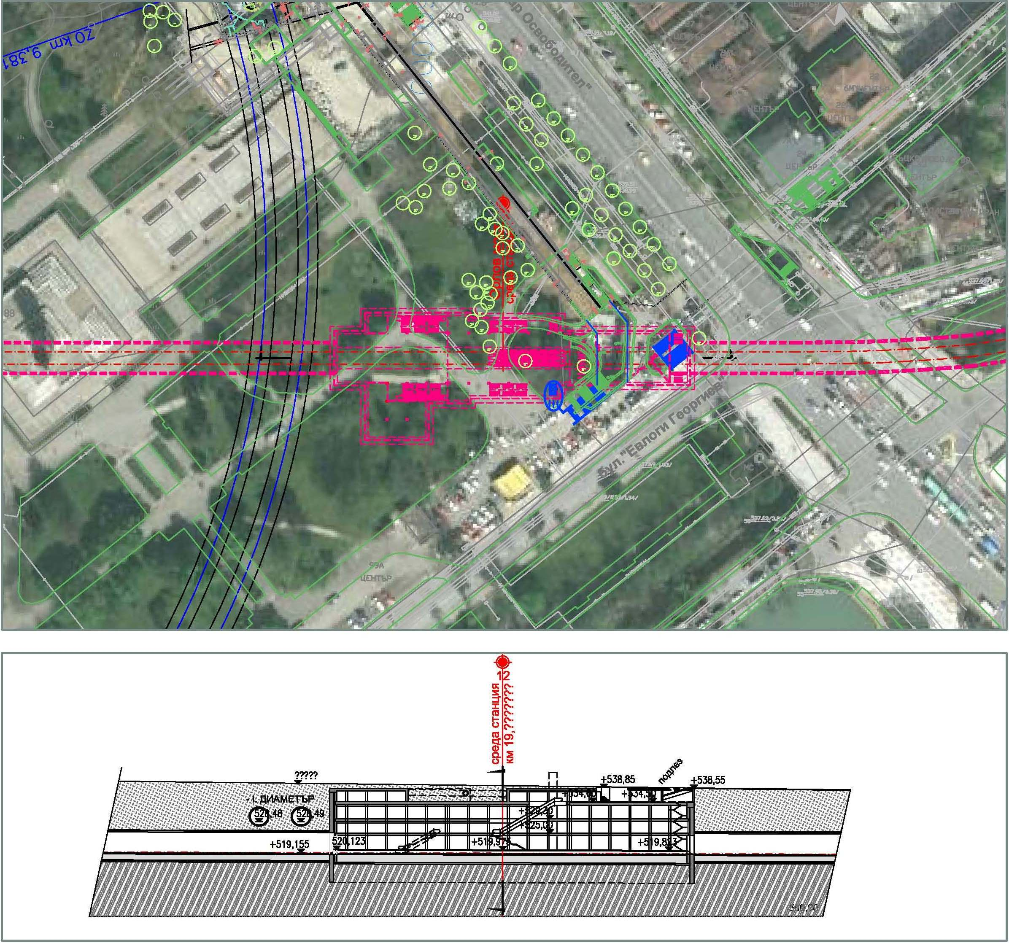
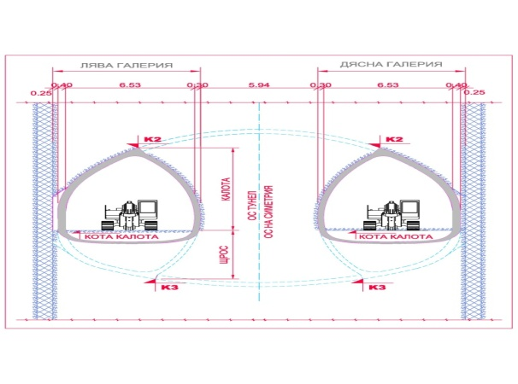
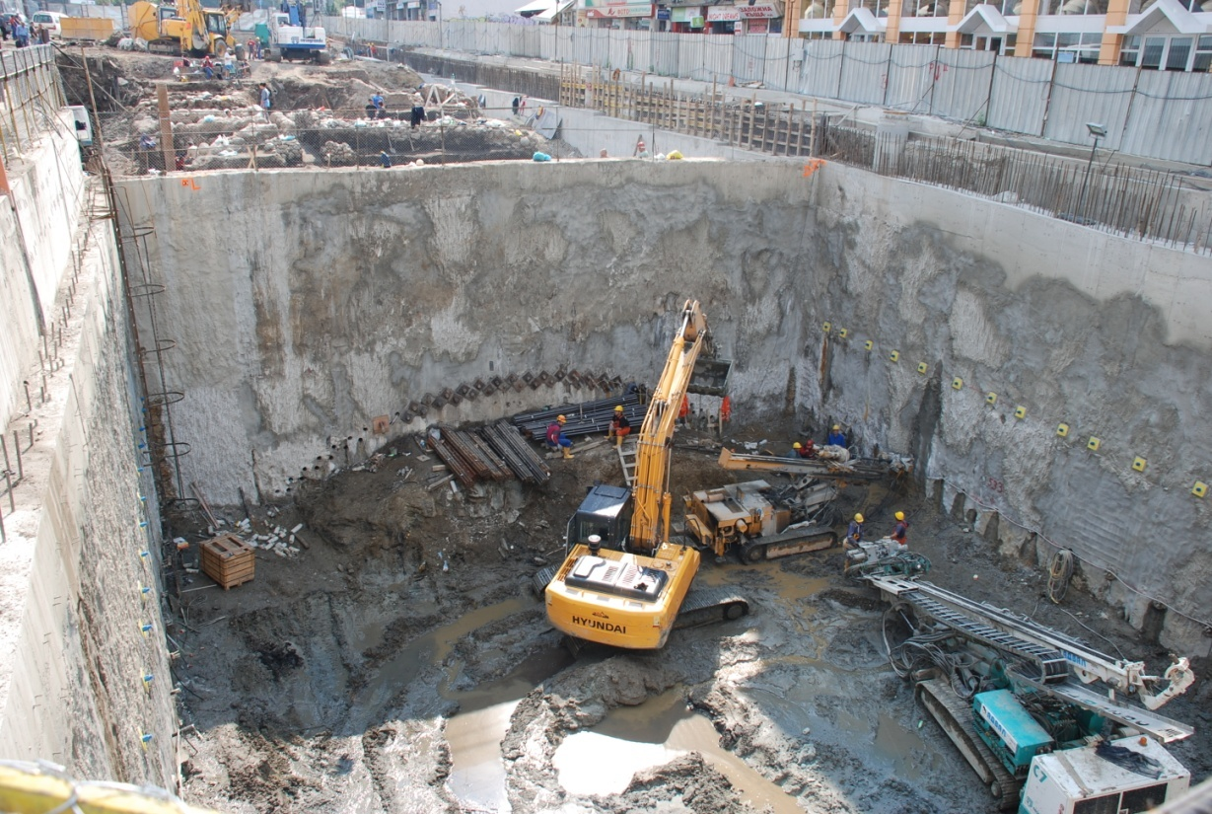
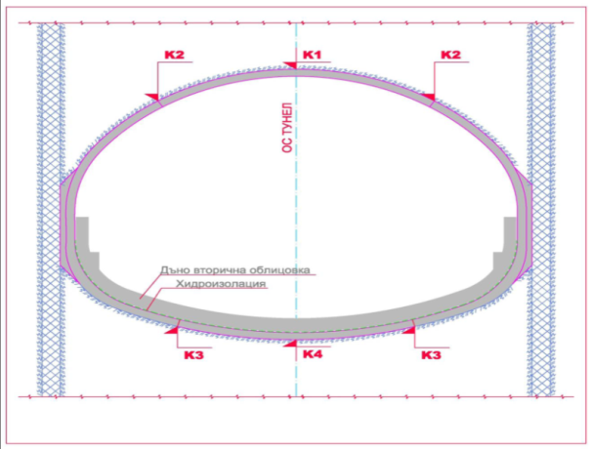
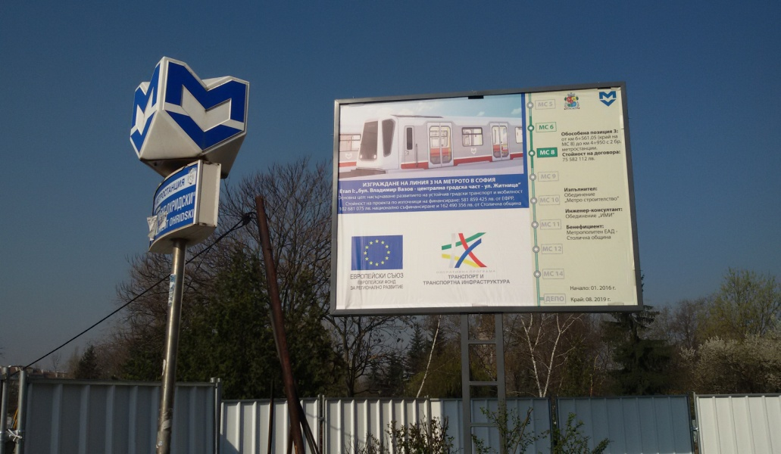
Location of MS ”Orlov Most” in the urban layout /connection to Line 1/
Connection Line 1 and Line 3
Phases of construction of MS Orlov Most
Схема

Slide 9
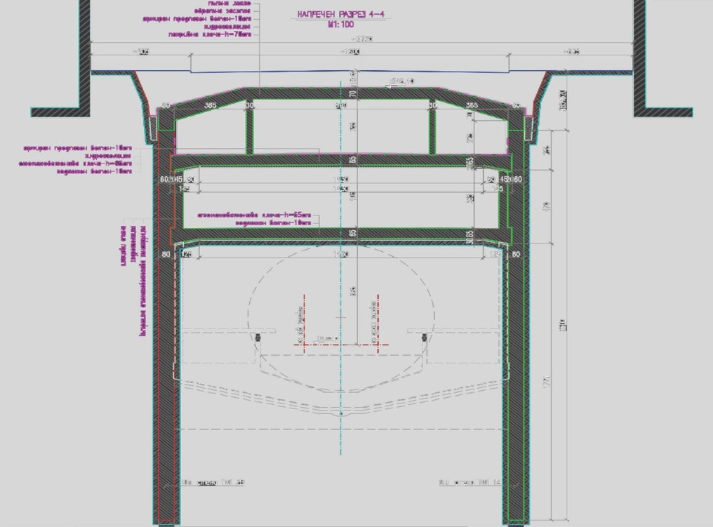
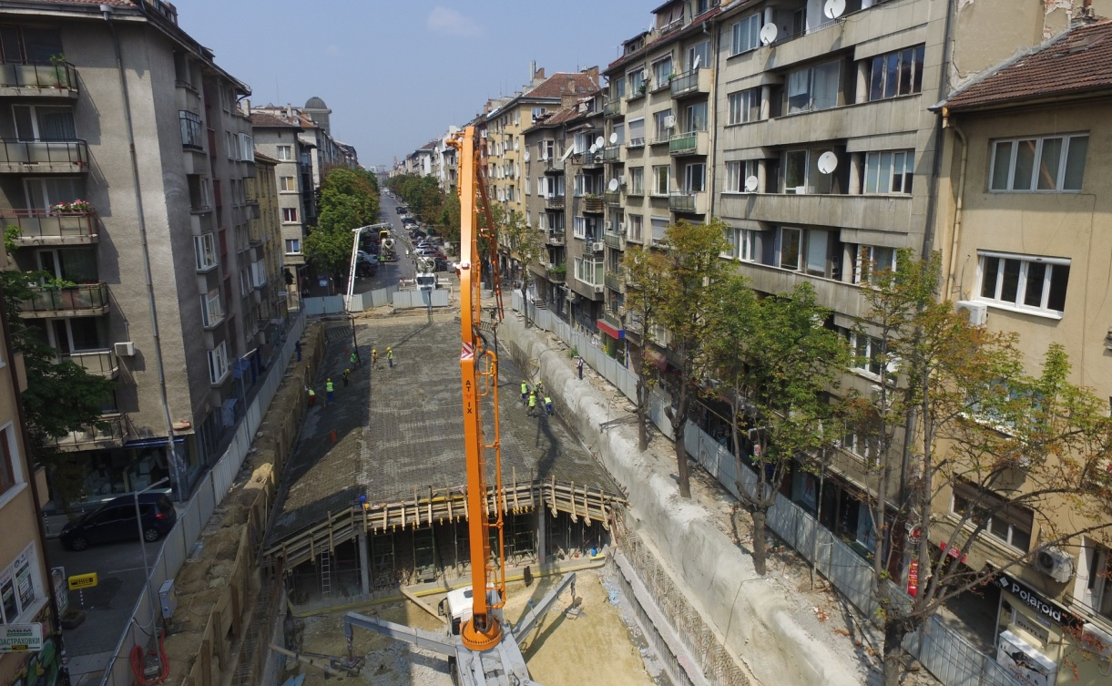
Location in the urban layout, structure scheme and construction of MS “Patriarh Evtimiy“
Construction of MS Patriarh Evtimiy

Slide 10
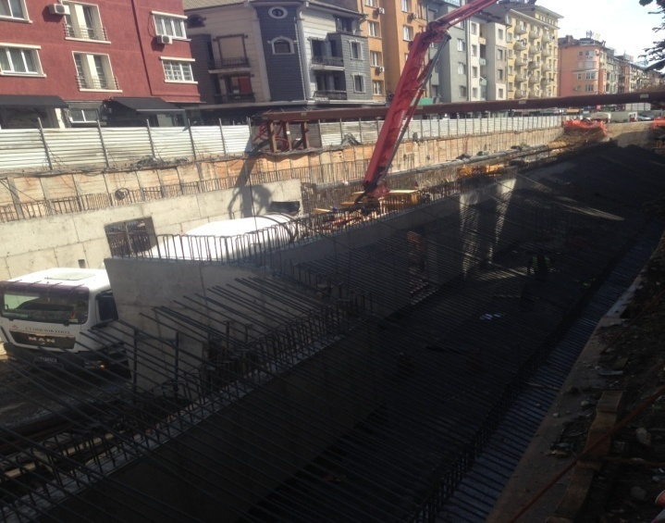
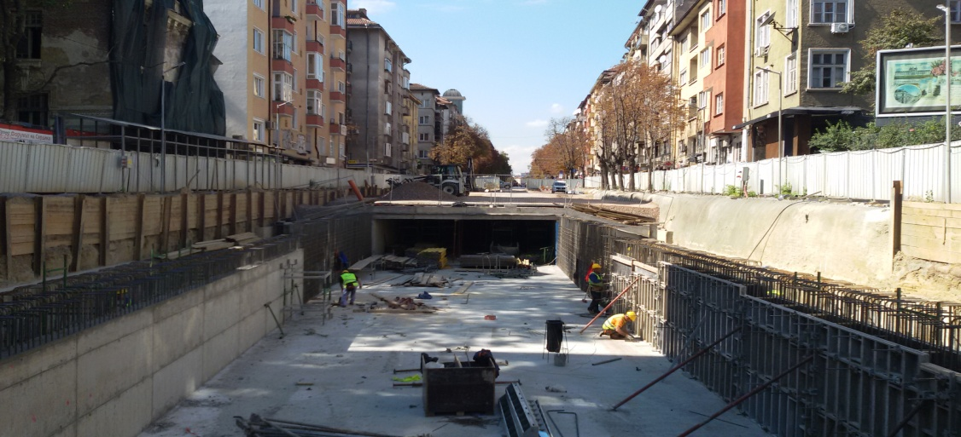
Layout, section and construction of MS “NDK 2“ from Line 3 (with connection to Line 2)

Slide 11
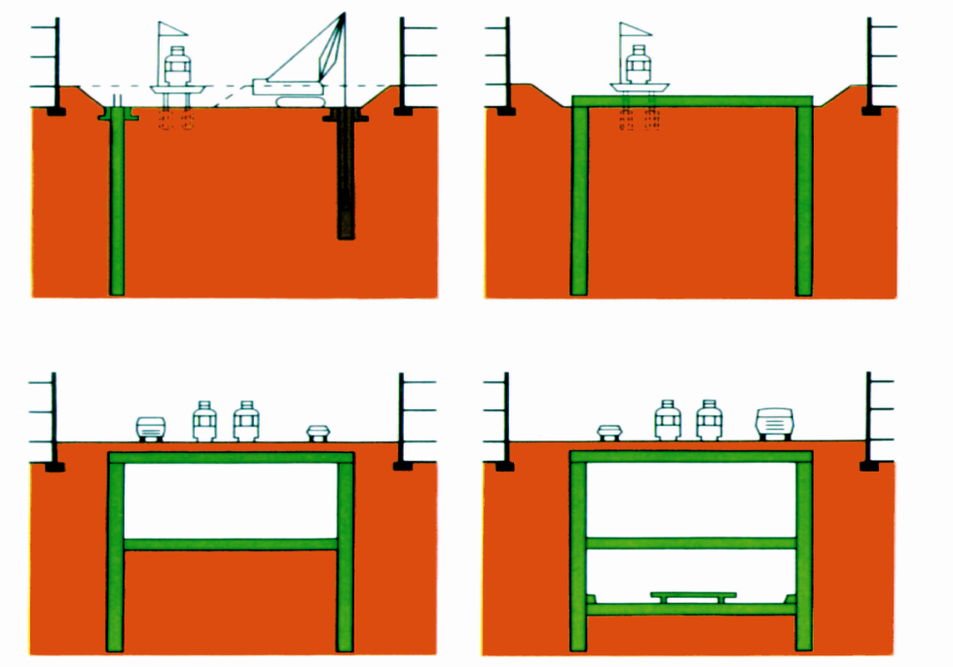
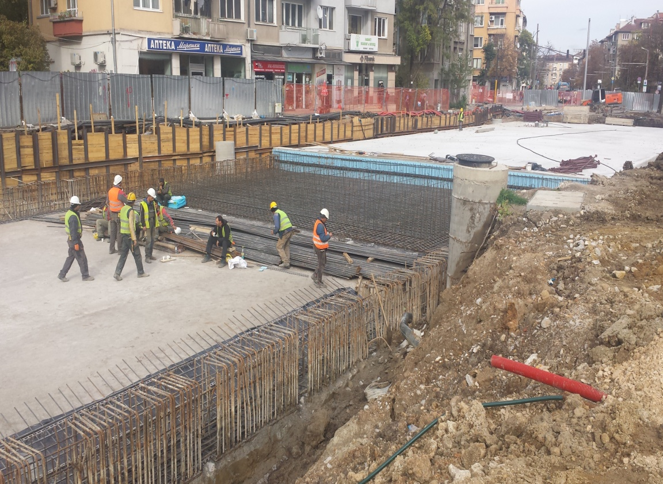
MS Medical Academy
location, technological scheme of its construction under “Top down” method
and construction process

Slide 12
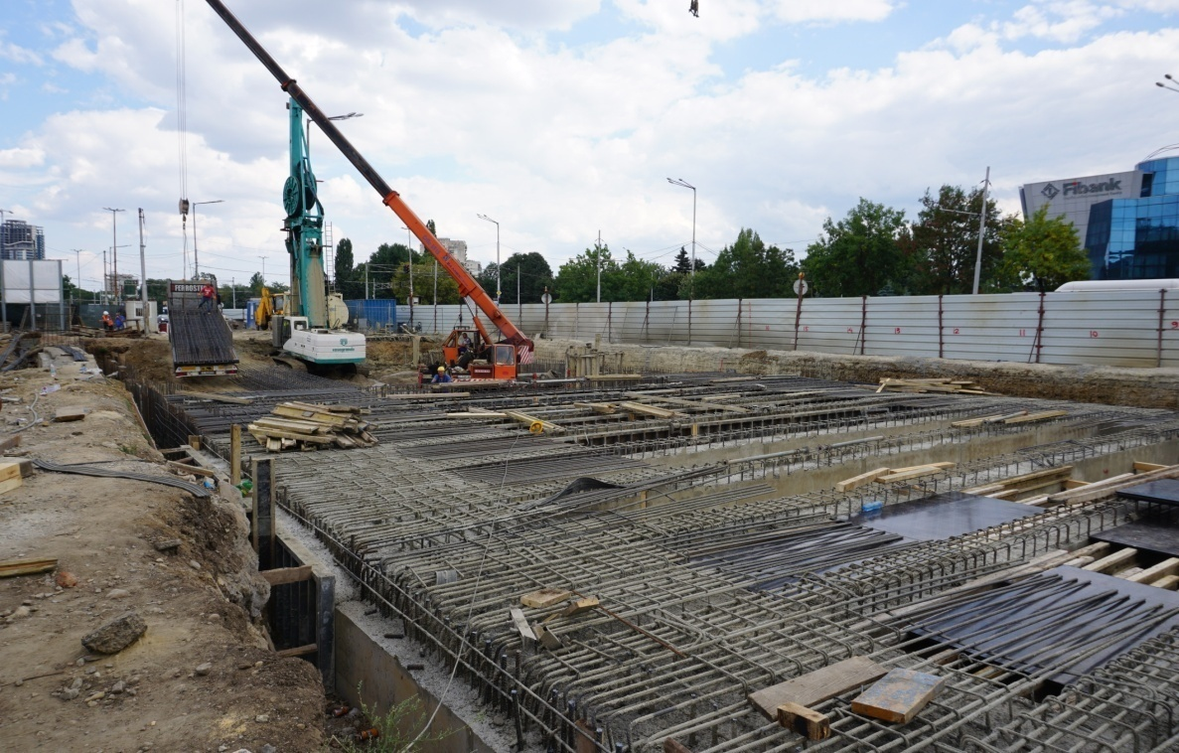
Location in the urban layout
and construction
of MS Bulgaria Boulevard

Slide 13
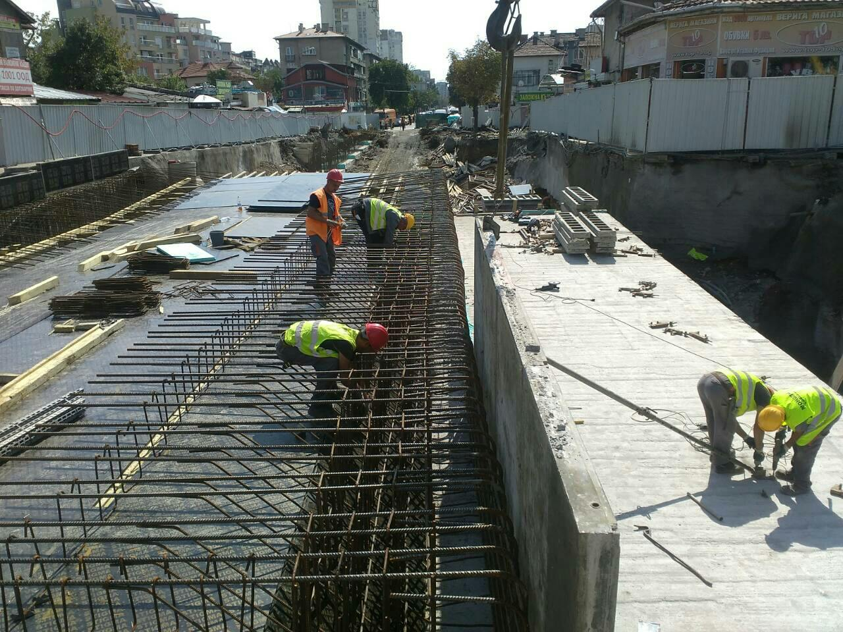
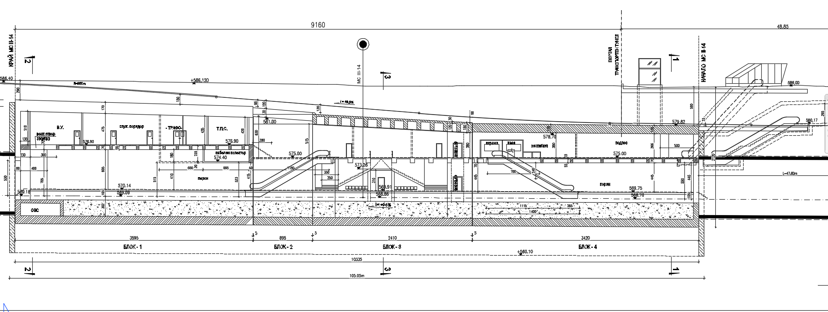
Location and construction process of MS “Krasno Selo” at the intersection of Tsar Boris III blvd. and Zhitnitsa str.
Longitudinal section along the axis
of the station

Slide 14
Layout, longitudinal section and cross section of the tunnels at the central city part of the route of Line 3

Slide 15
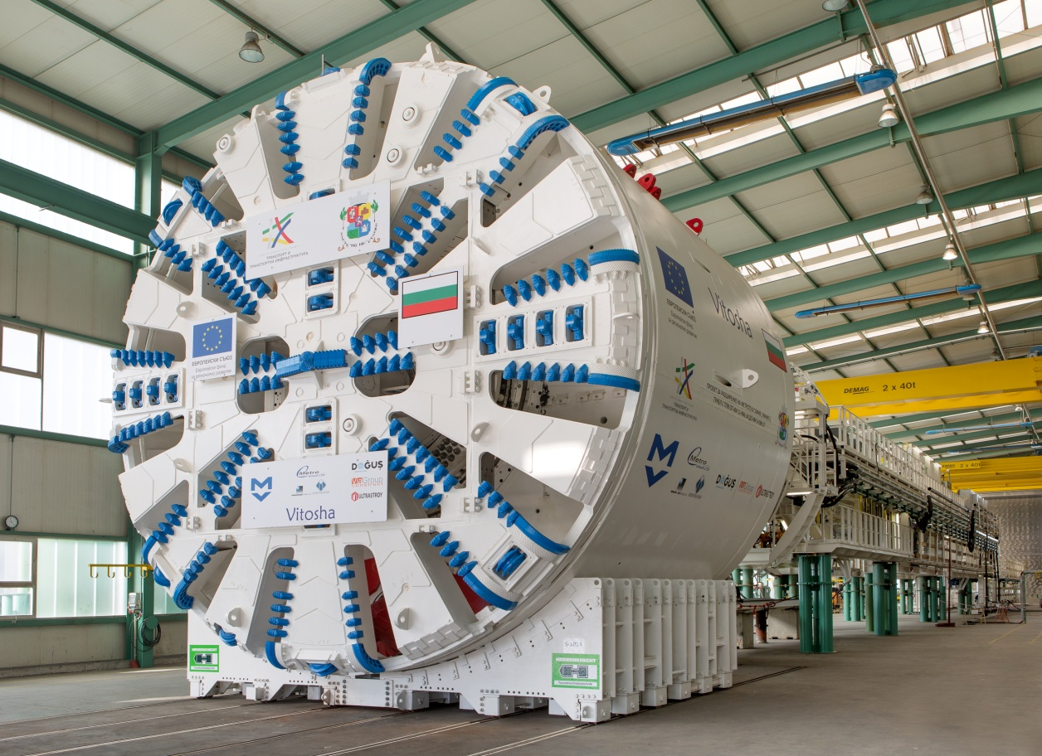
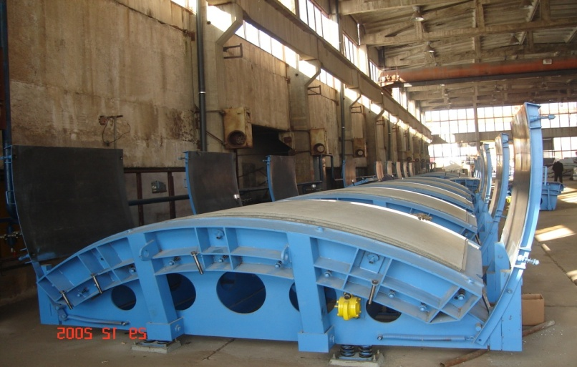
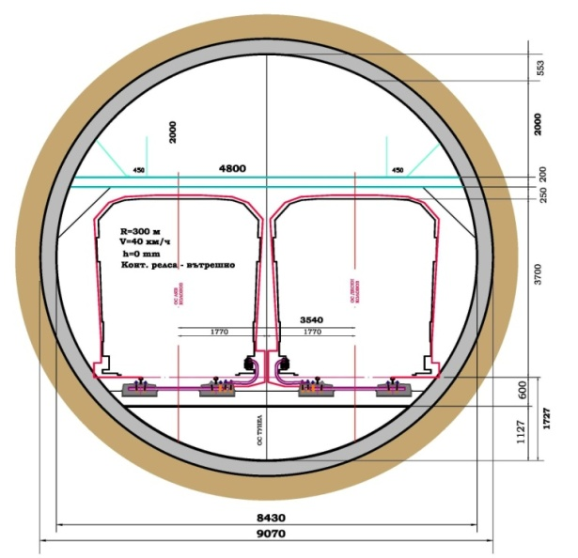
General view of the tunnel boring machine with a diameter of 9.4 m for construction of the double-road tunnels of Line 3 in the city center /accepting at the plant at Germany 10.2015/
Scheme of the tunnel structure and general view of the workshop for production of reinforced concrete segments of the tunnel structure

Slide 16
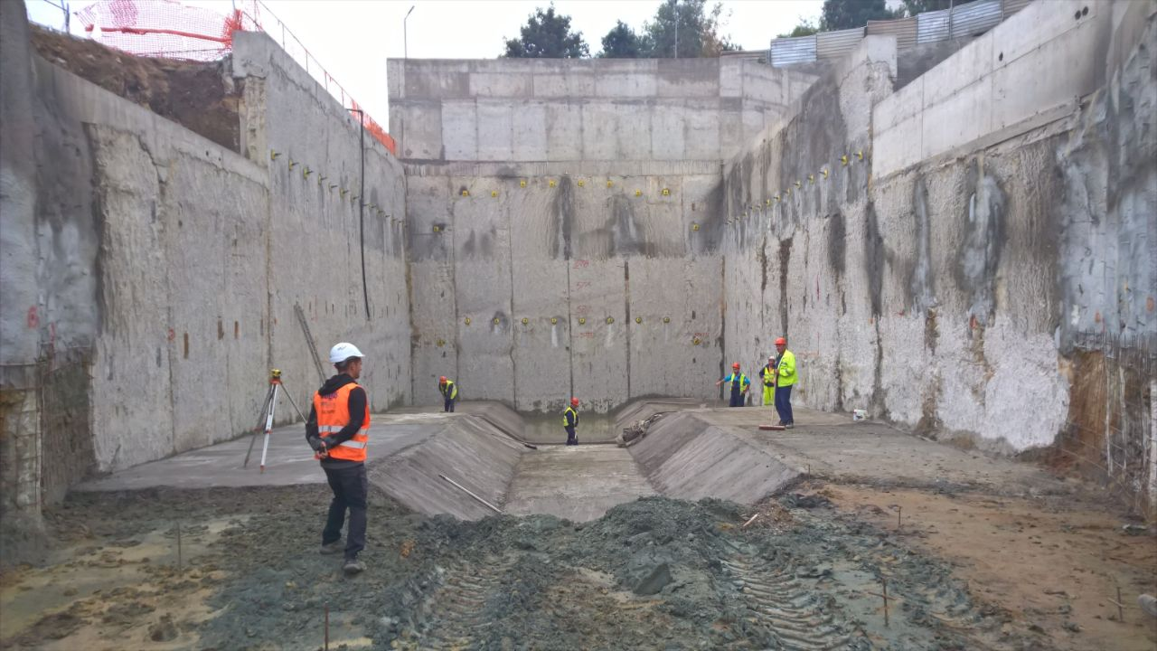
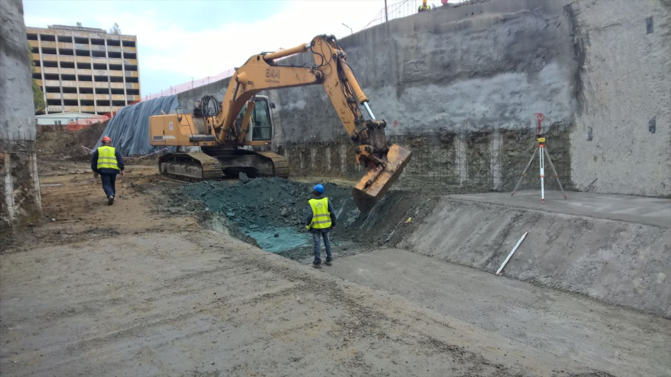
General view of the construction
of the launch for the operation
of the tunnel boring machine

Slide 17
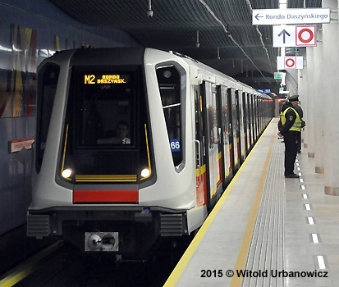
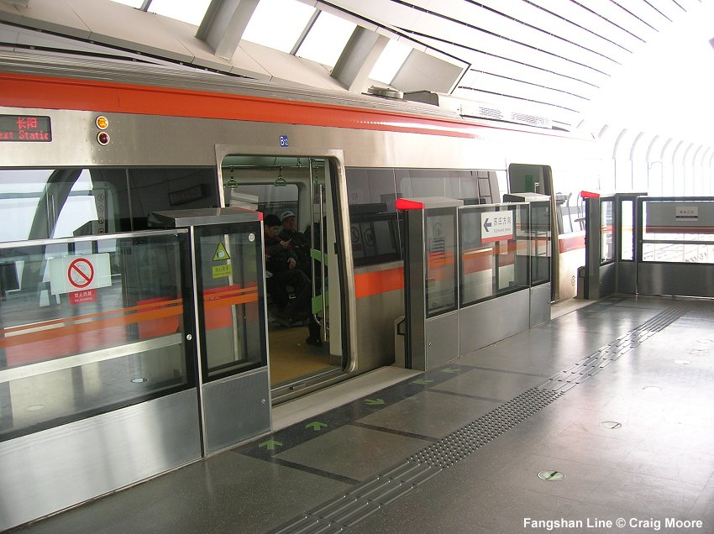
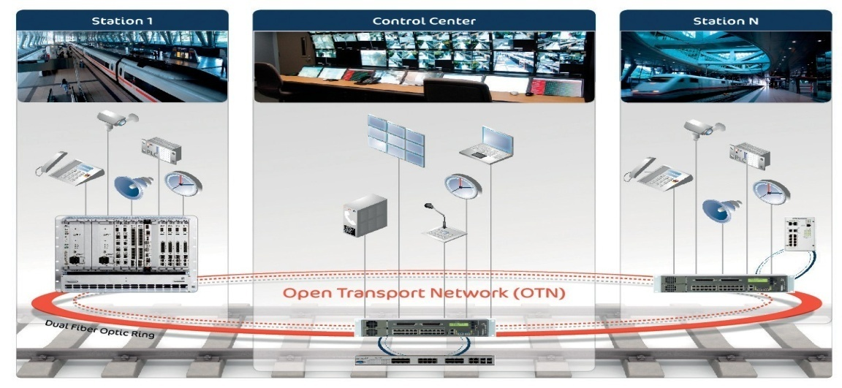
Rolling stock of the Inspiro model produced by the Siemens company
and the 1.5 m high automatically opened barriers for the platforms of Line 3
Scheme of the dispatch traffic control Scheme of transport automation
Станция 1
Контролен център
Станция N
Двоен оптичен ринг

Slide 18
Construction schedule of Stage 1 and Stage 2 of Line 3
of Sofia Metro Project
Sections and sites / Year | 2014 |  |  |  | 2015 |  |  |  | 2016 |  |  |  | 2017 |  |  |  | 2018 |  |  |  | 2019
Trimester | 1 | 2 | 3 | 4 | 1 | 2 | 3 | 4 | 1 | 2 | 3 | 4 | 1 | 2 | 3 | 4 | 1 | 2 | 3 | 4 | 1 | 2 | 3 | 4
Stage І
1. Central section “MS 6 Zaimov Park – Centre – MS 14 Zhitnitsa str.” with length of 7.150 km and 7 metro stations - Tender and other procedures - Tunnel construction – 42 months
2. Section from “MS 5 V. Vazov blvd. - MS 6 Zaimov Park” 650 m long and 1 metro station - Tender and other procedures - Construction – 32 months
3. Supply of rolling stock with transport automation and traffic control (СВТС system) - Tender procedures - Production – 36 months
4. Depot - Tender procedures - Construction – 22 months
5. Complex and commissioning tests and putting into operation
6. Stage II – section “MS 14 Zhithitsa str. – MS 18 Ring Road” 4.3 km long with 4 metro stations - Tender procedures - Construction – 30 months
- Tender and other procedures
- Implementation

Slide 22
PHISICAL IMPLEMENTATION (OCTOBER 2016)
STAGE І - CONSTRUCTION INSTALATION WORKS | 16.42%
LOT 1 | 15.09%
LOT 2 | 29.28%
LOT 3 | 14.16%
LOT 4 | 18.21%
ENGINEER CONSULTANT – LOT 1, 2, 3 AND 4 | 19.15%
METRO STATION 5 (New contract starting on 01.12.2016) | 0.00%
DEPOT (New contract starting on 01.12.2016) | 0.00%
ENGINEER CONSULTANT - MS 5, DEPOT AND CONTROL SYSTEMS (New contract starting on 10.11.2016) | 0.00%
SUPPLY OF TRAINS AND CONTROL SYSTEMS | 10.00%
SUPPLY OF TRAINS | 10.00%
CONTROL SYSTEMS | 10.00%
STAGE І - CIW + SUPPLY OF ROLLING STOCK | 14.12%

Slide 23
FINANCIAL IMPLEMENTATION – STAGE 1
/mln. euro/
Types of costs | Financial plan | Costs paid by the beneficiary | Costs verified by MA | Costs to be verified by MA | Financial rate
TOTAL: | 398,178 | 94,8 | 65,229 | 29,576 | 23,82%

Slide 24
Main parameters and public benefits by the Sofia Metro Extension Projects, included in the OPTTI 2014-2020
Total length of the extension:
of Line 2 – 1.3 km with 1 metro station
of Stage 1 and Stage 2 of Line 3 – 12 km with 12 metro stations
Main public benefits from the projects planned to be realized duding the programming period of OPTTI - 2014-2020:
Prognosticated number of passengers from section MS 2-11- МS 2-12 – 20 th. pass./day
Prognosticated number of passengers from Stage 1 and Stage 2 of Line 3 – 130 th. pass./day
- Total number carried passengers by metro after the completion
of the section of Line 2 and Stages 1,2 of Line 3 in 2019 – over 500 th. pass./day
- Additional saved time of traveling in the MPT only from Stages 1 and 2 of L3 – 45 th. hrs daily
- Traffic reduction from Stages 1 and 2 of L3 – over 20-25% along the route of the line
- Reduction of greenhouse gasses /only from Stages 1 and 2 of L3/ – 34 th. tones annually
- Total share of the metro in the public transport system after the completion
of the projects in OPTTI 2014-2020 – section MS 11-МS12 of L2 and Stages 1 and 2 of L 3 - over 45%

Slide 25
Metropoliten JSC 28-29 November 2016 Prof. PhD, eng. Stoyan Bratoev PhD, eng. Angel Dzhorgov

