Slide 1
ХVII Meeting of the
Monitoring Committee of
Operational programme “Transport” 2007-2013
.
19 - 20 November 2014 г.
Pravets

Slide 2
Agenda 19 November 2014
Status of projects implementation with beneficiary National Railway Infrastructure Company
Status of projects implementation with beneficiary National Company Strategic Infrastructure Projects
Status of projects implementation with beneficiary National Road Infrastructure Agency
Coffee-break: 15:30 – 16:00
4. Status of projects implementation with beneficiary “Metropolitan” PLC

Slide 3
Agenda 19 November 2014
5. Status of projects implementation with beneficiary Bulgarian Ports Infrastructure Company
Status of projects implementation with beneficiary Executive Agency for Exploration and Maintenance of the Danube River
Closing of the meeting
Dinner: 19:30

Slide 4
Agenda 20 November 2014
Adoption of the agenda and the minutes from the previous meeting
Presentation of EIB assistance in the railway sector in Bulgaria
Status of OPT implementation
Coffee-break: 11:00 – 11:30
Implementation of the Communication plan and publicity measures
Closing of the meeting
Lunch: 12:15 – 13:30
Departure to Sofia: 13:30

Slide 5
Annual implementation report for 2013
Drafted in accordance with Regulations 1083/2006 and 1828/2006
Contents information by the end of 2013 about :
  Overall physical and financial implementation
  Monitoring and evaluation measures
  Physical and financial implementation of investment projects
  Information and publicity measures
Officially submitted to the Commission on 27.06.2014, through the electronic exchange system SFC 2007.
07.07.2014 - declared admissible by the Commission services
13.08.2014 - approved by the EC services

Slide 7
Priority axis | Budget | Grant awarded | Value of eligible expenditure of commercial contracts | Paid
PO 1 | 660 000 000 | 704 630 263 | 675 517 498 | 476 655 932
PO 2 | 909 587 365 | 871 455 984 | 855 719 309 | 560 358 389
PO 3 | 333 193 801 | 333 193 801 | 326 878 049 | 267 062 977
PO 4 | 34 750 000 | 38 810 964 | 33 902 568 | 13 785 745
PO 5 | 65 950 000 | 59 846 692 | 26 376 899 | 25 243 057

Slide 8
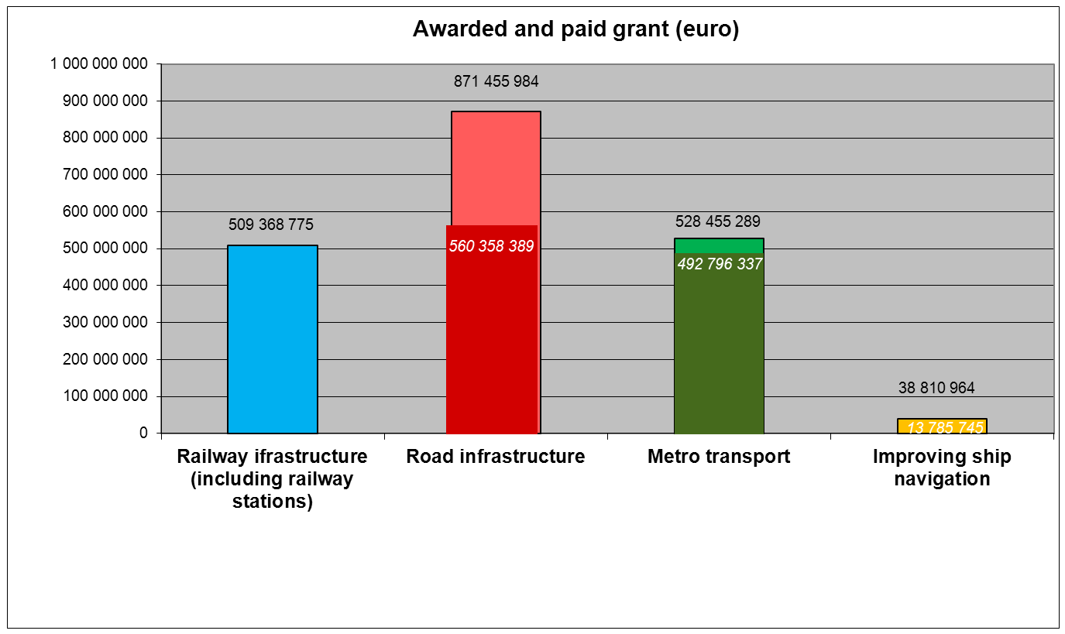
250 922 577

Slide 9
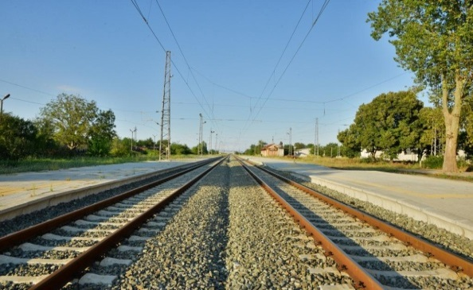
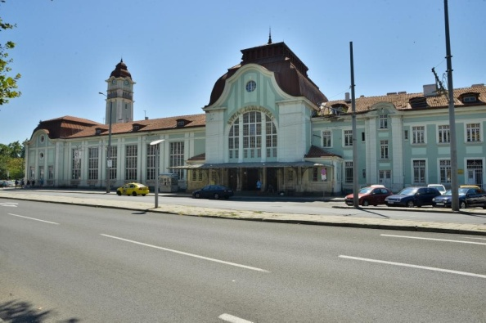
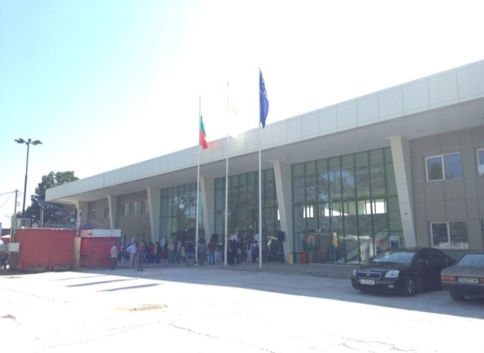
Railway infrastructure
More than 242 km of railway lines were rehabilitated (track length), more than 260 km railway lines are under rehabilitation
After the previous meeting :
  Started the construction of signaling systems in the railway section “Plovdiv – September” and telecommunications of Sofia-Plovdiv section (08/04/2014) and modernization of railway station “Burgas” (14/07/2014)
  Railway “Pazardzhik” station was officially opened on 19/09/2014
  Enhanced monitoring of the identified high-risk projects - "Parvomai -Svilengrad" (Position 1 and 2), "September" - Plovdiv (Position 2) and "Plovdiv - Burgas" (Position 3) is being performed –operational meetings are held, on the spot checks (2) and site visits with the Head of MA of OPT (3) are performed

Slide 10
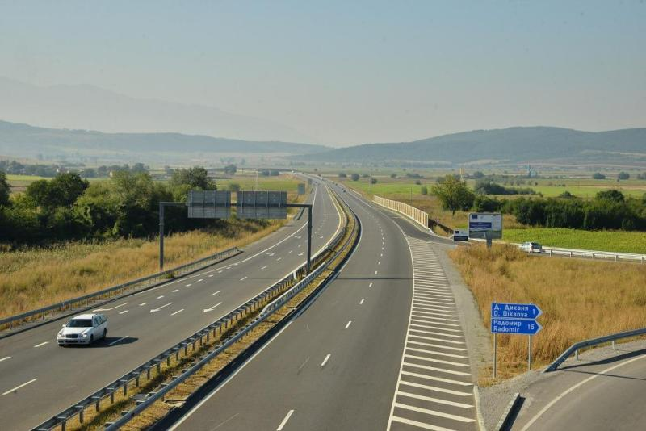
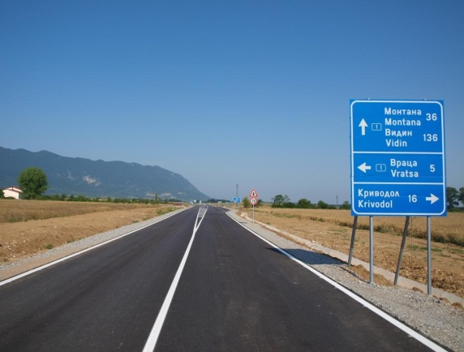
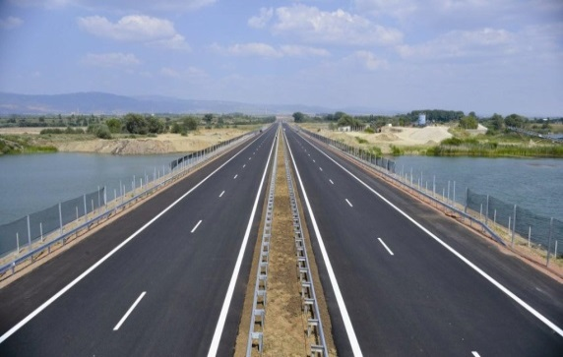
Road infrastructure
More than 140 km of motorways were constructed
More than 49 km I class roads were constructed and reconstructed
Under construction are more than 125 km of motorways and more than 28 km of I class roads
After the previous meeting was completed the project "Vratsa Bypass - Route I-1 (E79)" (06.07.2014)
Enhanced monitoring of the identified high-risk projects - "Maritsa" (Lot 1); "Struma" (Lot 2 and 4); “Construction of West arc of Sofia Ring Road" (Lot 1) “Gabrovo Ring Road" is being performed- operational meetings are held, on the spot checks (5) and site visits with the Head of MA of OPT (6) are performed.

Slide 11
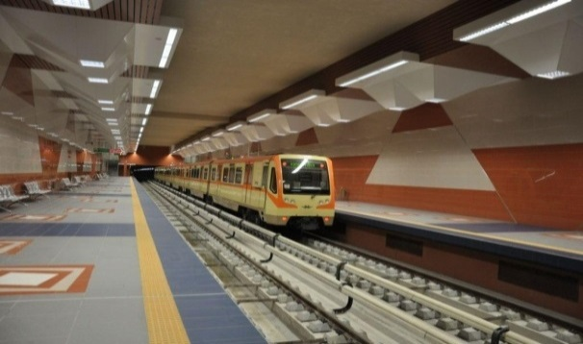
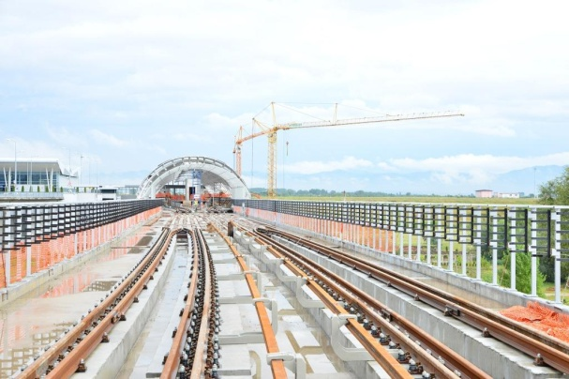
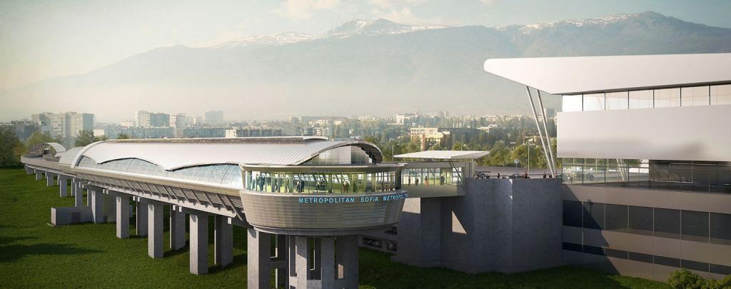
Metro
13 new metro stations and 13 km of new metro railways are built
Under construction are new 7.6 km of metro lines and 7 metro stations which are scheduled to be completed in the first half of 2015
It is expected that 60,000 passengers per day will travel on the newly built section

Slide 12
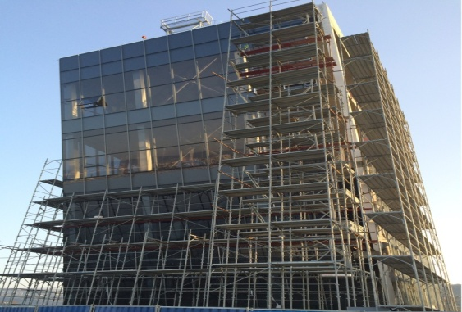
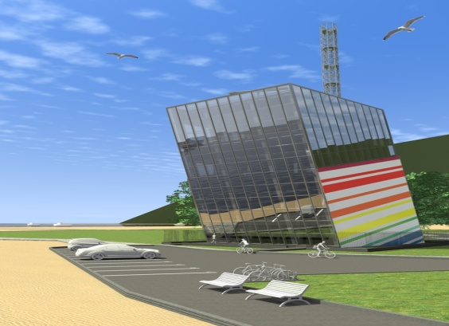
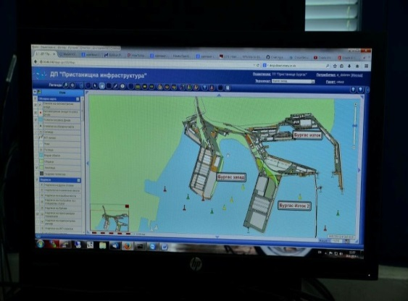
Improvement of maritime and
inland-waterway navigation
After the previous meeting ended the rough construction of the traffic towers in Varna and Burgas, part of VTMIS – Phase 3 project
After the previous meeting the construction, technical equipment and furnishing of the building of the RIS center of Ruse was completed at 100% - signed Act 15 17/10/2014
Successfully was completed the project "Design and implementation of a geographic information system (GIS) for management of the port infrastructure" - the system was put into operation in September 2014 самата система е въведена в експлоатация през м. август 2014 г.

Slide 13
Thank you for your attention!
www.optransport.bg

